Slide 1
Dynamic Assessment: Examining Learning Potential and Reducing Bias in Assessment
Marie C. Ireland M.Ed., CCC-SLP, BCS-CL

Slide 2
Disclosure
I have no financial relationship with ASHA. I am not being compensated to present information at this year’s conference.
I am the current Vice chair of the SLP Advisory Council and Clinical Representative for the Schools on the ASHA Publications Board (non-financial relationship).

Slide 3
Do you assess children who are…

Slide 4
Dynamic Assessment
“…Can help identify learning potential and eliminate bias for students with cultural and linguistic differences or socio-economic risk factors.”
Virginia Department of Education, 2013

Slide 5
Dynamic Assessment
“…assessment which seeks to identify the skills that an individual child possesses as well as their learning potential.”
“…is highly interactive and process-oriented.”
Retrieved from http://www.asha.org/practice/multicultural/issues/ Dynamic-Assessment/

Slide 6
Dynamic assessment
“Dynamic assessment measures how a student responds to intervention and the difference between what the student can learn unaided, and what he or she can learn with assistance.…”
Virginia Department of Education, 2013

Slide 7
After testing, have you ever...
Asked a follow up question because you wanted to know what the child was thinking?
Given a second try without a timer?
Given additional practice?
Paraphrased the directions?

Slide 8
Dynamic Assessment
Methods Include:
Graduated Prompting
Testing Limits
Test-Teach-Retest
Use with any type of task to examine potential for learning / growth
Gutieérrez-Clellen, V. F. & Penña, E. (2001). Dynamic Assessment of Diverse Children A Tutorial. Lang Speech Hear Serv Sch, 32(4), 212-224

Slide 9
A Quick Recap of Why this is Important

Slide 10
A Must Read Publication
Spaulding, T., Plante, E., Farinella, K. (2006) Eligibility Criteria for Language Impairment -Is the Low End of Normal Always Appropriate?, Language, Speech, and Hearing Services in Schools Vol.37 61-72
“The practice of applying an arbitrary low cut-off score for diagnosing language impairments is frequently unsupported by the evidence that is available …in test manuals.”

Slide 11
Expectations in the Literature
Sensitivity > 80%
Correct identification as impaired
-------------
Specificity >80%
Correct identification as typical

Slide 12
“Perhaps the most discouraging finding of this study was the lack of correlation between frequency of test use and test accuracy…assuming the ideal goal for diagnosis is 100% correct classification of children, accuracy levels should correlate with frequency of test use.” Betz, Eickhoff, & Sullivan, 2013

Slide 13
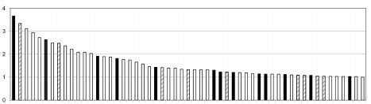
Black bars: >80% sensitivity & specificity
Hashed bars: <80%
White bars: unknown
Betz, S. K., Eickhoff, J. R., & Sullivan, S. F. (2013). Factors Influencing the Selection of Standardized Tests for the Diagnosis of Specific Language Impairment. Lang Speech Hear Serv Sch, 44(2), 133-146

Slide 14
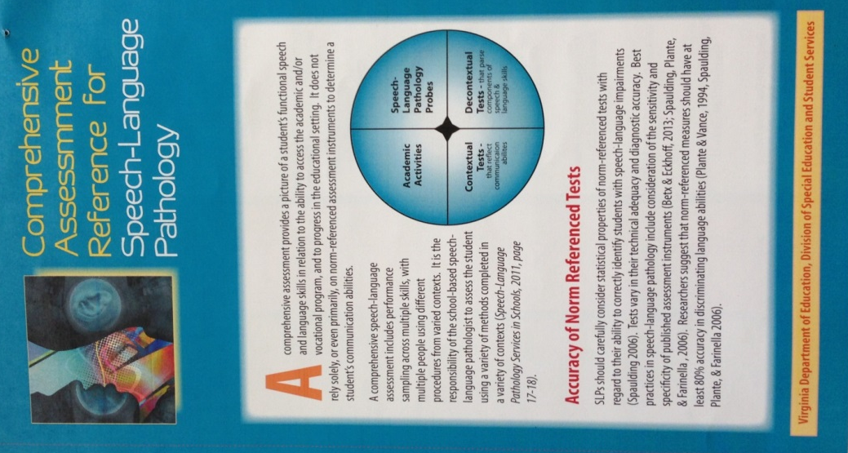
Comprehensive Assessment Reference
Information and references
Specific data for 13 tests
Information from publisher and research may conflict
Designed to assist SLPs in discussing need for additional data sources
www.doe.virginia.gov search “SLP”

Slide 15
Federal Regulations 34 CFR §300.304
“No single measure or assessment is used as the sole criterion for determining whether a child is a child with a disability”
“Use technically sound instruments…”
“Assessment and other evaluation tools…are selected and administered as not to be discriminatory on a racial or cultural basis”

Slide 16
Overview of Dynamic Assessment

Slide 17
Consider two cases
Student Effort
Student Performance

Slide 18
Is there a concern in reporting a single score without dynamic assessment data?

Slide 19
Dynamic Assessment
Methods Include:
Graduated Prompting
Testing Limits
Test-Teach-Retest
Use with any type of task to examine potential for learning /growth

Slide 20
Dynamic Assessment Measures
Formal Systems
Dynamic Assessment and Intervention Kit: Improving Children’s Narrative Abilities
PEARL (Predictive Early Assessment of Reading and Language)
Narrative Language Measures®
Other purchased tools

Slide 21
Dynamic Assessment Measures
Informal Systems
School Age Language Measures (SLAM)
Story Champs
Destination Imagination
Test-teach-retest using standardized and norm referenced tests as the “test”

Slide 22
Mediated Learning Components ( the Teach)
Intentionality | Teach, create awareness in the child
Meaning | Help child to understand why task is important
Transcendence | Help child think hypothetically
Competence | Teach child to be self-regulated & active participant in own learning
www.asha.org/practice/multicultural/issues/components

Slide 23
Mediated Learning Strategies
Assist student in meeting target and building competence
Examples include:
Provide a model
Additional time
Paraphrasing or shortening of directions
Visual prompts or cues
Encourage elaboration with questions

Slide 24
Consider Responsiveness
How does the child respond?
Does the child maintain attention to task?
Does the child utilize the learning strategies provided?

Slide 25
Consider Transfer & Effort
Transfer
How well does child apply new skills?
Does child needs prompts to apply strategies?
Examiner Effort
How much support did you provide?
How intense in the support?

Slide 26
SLP’s Clinical Judgment
Practice improves performance
Inter rater reliability is stronger at the ends of the spectrum
This is NOT the only piece of data used in decision making

Slide 27
Examine Modifiability
Consider the student’s stimulability
Modifiability / Responsiveness
Prompts
Errors
Confidence
Rate
Effort (child and adult)

Slide 28
The impact of Poverty on language
Considerations for Assessment

Slide 29
Why Does The Gap Persist?
“Three-year-old children in professional families had a vocabulary as large as
that of the parents
in the study who were on welfare.”
Barton, 2004
www.ascd.org/publications/educational-leadership/nov04/vol62/num03/Why-Does-the-Gap-Persist%C2%A2.aspx

Slide 30
“The disproportionate use of vocabulary measures compared to morphosyntactic measures suggests that the content of the most frequently used standardized tests is not necessarily supported by the existing research literature.”
Betz, Eickhoff, & Sullivan, 2013

Slide 31
Early Language Experiences Quantitative Differences
 | Words heard per hour | Words heard in a 100-hour week | Words heard in a 5,200-hour year | Words heard in 4 years
Professional Family Child | 2,153 | 215,000 | 11 million | 45 million
Working Class Family Child | 1,251 | 125,000 | 6 million | 26 million
LOW SES Child | 616 | 62,000 | 3 million | 13 million
Hart, B., & Risley, T. R. (1995). Meaningful differences in the everyday experience of young American children. Baltimore: P.H. Brookes.
Notes:
This chart is based on the findings of Hart and Risley.
Notice the significant differences in the number of words young children hear in their homes each hour, week, year and within a four year time frame. Children who are growing up in professional homes hear almost 4 times as many words as those children in welfare homes.
The significant difference in the oral language development of children from professional homes to those from welfare homes is not just the quantity of words heard – but the quality of word use.
NOTE: The presenter should clarify that the terms: professional, working class, and welfare – are the terms Hart and Risley use to denote differences in family setting and language. (Some participants are offended by these terms.)
The presenter should also explain that the quantitative and qualitative differences in language interaction are NOT indicative of how much a parent or caregiver loves or cares for the child.

Slide 32
Early Language Experiences: Qualitative Differences
 | Words heard per hour | Affirmatives per hour | Prohibitions per hour
Professional family child | 2,153 | 32 | 5
Working class child | 1,251 | 12 | 7
LOW SES Child | 616 | 5 | 11
-Hart & Risley (1995)
Notes:
The research by Hart and Risley indicates that parents with higher levels of income:
Engage in more interactive discussions with their children
Expand their children’s verbal responses by repeating the child’s statement as a question.
Use more sophisticated language with their children than parents from welfare homes.
(Hart & Risley, 1995)

Slide 33
The Effects of Weaknesses in Oral Language on Reading Growth
High Oral Language in Kindergarten
16
15
14
13
12
11
10
9
8
7
6
5
5.2 years difference
Low Oral Language in Kindergarten
Reading Age Level
5 6 7 8 9 10 11 12 13 14 15 16
Chronological Age
Notes:
This graphic depicts Biemiller’s work – indicating the impact of oral language on reading growth.

Slide 34
Vocabulary
Test Name | Mean Score Typical Language | Mean Score Children with LI
PPVT-III | 100 | 93.98
PPVT-IV | 100 | 93.68
Spaulding, T., Hosmer, S., & Schechtman C. Investigating the interchangeability and diagnostic utility of the PPVT-III and PPVT-IV for children with and without SLI.

Slide 35
Vocabulary
African American children (typically developing) from low income households
Test Name | Mean Score
Expressive Vocabulary Test | 90.58
PPVT-III | 91.5
McCabe & Champion (2010) A Matter of Vocabulary II: Low-Income African American Children’s Performance on the Expressive Vocabulary Test

Slide 36
Semantic Knowledge
Static Assessment
Vocabulary tests measure exposure to words
Highly effected by SES and mother’s education
Dynamic Assessment
Measures ability to learn new words
Differentiates WNL from SLI
Fast Mapping (Dollaghan, 1987)

Slide 37
Tier 2 Words
Words that are used in text and during classroom discussions.
Instruction in general education should address these needs
Search “Tier 2 Vocabulary”
https://www.flocabulary.com/wordlists/
http://www.hpcsd.org/district.cfm?subpage=29208

Slide 38
What Grade Level?
Grade 1 | Grade 6
Annoy Attention Calm Comfortable Consequence Curious Curve Ignore Important | Dimension Drastic Elaborate Encourage Equation Evaluate Exaggerate Exhaust Expression
What Grade Level?

Slide 39
Consider Home Culture
Examine experiences with
Locus of control for behavior
Structure and use of routines
Use of rigid time limits
Temporal concepts (first, next, then)
Language and story use

Slide 40
Examples of Dynamic assessment methods

Slide 41
What can you learn?
Personal Efficacy Behaviors
Self talk, perseverance, etc.
Attention
Imitation
Problem Solving
Memory
Emotional state

Slide 42
Fast Mapping
Measures the ability to learn novel words from exposure rather than vocabulary tests that differentiate socio-economic classes
Significant differences between typically developing and children with SLI

Slide 43
View video online at http://www.leadersproject.org/2015/03/16/nonword-repetition-assessment-task/

Slide 44
Mapping in Normal and Language-Impaired Children
Dollaghan, C. A. (1987). Fast Mapping in Normal and Language-Impaired Children. J Speech Hear Disord, 52(3), 218-222. doi: 10.1044/jshd.5203.218.

Slide 45
Moog

Slide 46
durpy

Slide 47
lohr

Slide 48
Point to the. . .
Notes:
Moog
Gowler
Durpy
Lohr

Slide 49
What are these?

Slide 50
What are these?

Slide 51
Fast Mapping
Presentation of item and novel word
Did incidental learning occur?
Receptive language
Expressive language
Are prompts are required?
What techniques assist the student in learning new words?

Slide 52
Destination Imagination
Quick interactive tasks
“Instant Shaker” or “Printables”
Designed to stimulate creative processes
Use to examine:
Organization
Planning
Language
Problem Solving

Slide 54
Examples from the PEARL
Dynamic Assessment of Decoding and Language
Uses Test-Teach-Retest method
Interpretation and Recommendations are based on:
Student pre and post scores
Responsiveness
Images of PEARL Record Form 1.
Used with Permission

Slide 55
Test Phase

Slide 56
Teach Phase

Slide 57
RETEST Phase

Slide 58
Narrative Assessment

Slide 59
The diagnostic accuracy of distinguishing a language difference from language impairment is substantially increased when LSA is used in conjunction with standardized testing (Horton-Ikard, 2010).

Slide 60
The Article
Language Sample Analysis With Children Who Speak Non-Mainstream Dialects of English, RaMonda Horton-Ikard, SIG 1 Perspectives on Language Learning and Education, March 2010, Vol. 17, 16-23. doi:10.1044/lle17.1.16

Slide 61
Narrative Analysis
Macrostructure
Story Grammar
Episodic Complexity
Microstructure
Literate Language
Cohesion
Clauses

Slide 62
Free Narrative Resources
www.doe.virginia.gov and search “SLP”
Free Resources
School Age Language Measure Cards
Narrative Protocol for Picture Prompted Stories
Online modules with quiz and certificates

Slide 64
Story Champs
Narrative tools for regular or special education staff (small or large group)
Pre-k through High School
Resources:
Scripted Stories
Icons for story parts
Written language activities
Story Champ Blitz extensions for older students

Slide 65
Example of contents

Slide 66
Why Use Narratives?
Relevant & contextualized task (content is taught as stories)
Research shows up to 100% sensitivity and specificity as dynamic assessment tool
Examine for multiple areas in one task
Morphology
Syntax
Semantics
Pragmatics

Slide 67
Evaluation Reports and dynamic assessment

Slide 68
Report Sections
Assessment Data
Standardized/norm referenced
Dynamic Assessment and Language Sample Analysis
Analysis/Interpretations
Recommendations
Reporting scores is NEVER enough

Slide 69
Dynamic assessment data
Dynamic assessment data is a valid source of data in IDEA
Evaluation and Eligibility
Regulations
Written reports should contain data from these activities

Slide 70
Dynamic Assessment
Document type of dynamic assessment, materials used, and mediated learning sessions
Describe strategies and student performance and modifiability

Slide 71
Documentation
Consider including:
Summary of task and data
Comparison data (typical expectation or examples )
Summary of strengths and weakness
Provide citations when appropriate to address:
Diagnostic accuracy
Research on usage
Administration manual
Regulations and state/professional guidance

Slide 72
A Review of what we have learned

Slide 73
Dynamic Assessment
Diagnostic accuracy is high and documented in the literature
Reduces cultural and linguistic bias compared to norm referenced and standardized tests

Slide 74
Dynamic Assessment
Methods Include:
Graduated Prompting
Testing Limits
Test-Teach-Retest
Use with any type of task to examine potential for learning /growth

Slide 75
Techniques include
Hands on Tasks (e.g., destination imagination or toys and spoons)
Fast Mapping
Free narrative tools (e.g., SLAM cards and NLM³)

Slide 76
Techniques include
Purchased assessment tools (e.g., PEARL, Dynamic Assessment and Intervention Kit)
Purchased systems (e.g., Story Champs, Mindwing Concepts narrative tools)

Slide 77
Dynamic Assessment
Uses YOUR unique training and skills
Differentiates between difference and disorder
Reduces bias in assessment
Informs instruction and leads to clear recommendations
Informs treatment (if required)

Slide 78
References
Betz, S. K., Eickhoff, J. R., & Sullivan, S. F. (2013). Factors Influencing the Selection of Standardized Tests for the Diagnosis of Specific Language Impairment. Lang Speech Hear Serv Sch, 44(2), 133-146.
Dollaghan, C. A. (1987). Fast Mapping in Normal and Language-Impaired Children. J Speech Hear Disord, 52(3), 218-222. doi: 10.1044/jshd.5203.218.
Gutieérrez-Clellen, V. F. & Peña, E. (2001). Dynamic Assessment of Diverse Children A Tutorial. Lang Speech Hear Serv Sch, 32(4), 212-224
Hart, B., & Risley, T. R. (1995). Meaningful differences in the everyday experience of young American children. Baltimore: P.H. Brookes.
Horton-Ikard, R. (2010) Language Sample Analysis With Children Who Speak Non-Mainstream Dialects of English, SIG 1 Perspectives on Language Learning and Education, March 2010, Vol. 17, 16-23
McCabe & Champion (2010) A Matter of Vocabulary II: Low-Income African American Children’s Performance on the Expressive Vocabulary Test. Communication Disorders Quarterly
Spaulding, T., Hosmer, S., & Schechtman C. (2013) Investigating the interchangeability and diagnostic utility of the PPVT-III and PPVT-IV for children with and without SLI. International Journal of Speech-Language Pathology Pages 453-462. 04 Feb
Spaulding, T., Plante, E., Farinella, K. (2006) Eligibility Criteria for Language Impairment-Is the Low End of Normal Always Appropriate?, Language, Speech, and Hearing Services in Schools Vol.37 61-72

Slide 79
Online Resources
www.ascd.org/publications/educational-leadership/nov04/vol62/num03/Why-Does-the-Gap-Persist%C2%A2.aspx
www.asha.org/practice/multicultural/issues/components
www.doe.virginia.gov/special_ed/disabilities/speech_language_impairment/index.shtml
www.doe.virginia.gov/special_ed/disabilities/guidance_evaluation_eligibility.docx
www.asha.org/practice/multicultural /issues/Dynamic-Assessment/
www.destinationimagination.org/challenge-program/resource-library
www.languagedynamicsgroup.com
www.leadersproject.org

Slide 80
You can do this!

