Slide 1
2017’s Hottest Tickets in School Based Practice: Screening the Blockbuster Issues and Solutions
Perry Flynn, Marie Ireland, Barbara Conrad, Mary O’Connor, Elizabeth Christopher
Members of the State Education Agencies Communication Disabilities Council (SEACDC)
2017 ASHA Convention

Slide 2
Disclaimer Slide
The presenters have no relevant financial relationship(s) within the products or services described, reviewed, evaluated or compared in this presentation.
The presenters have nonfinancial relationships to disclose as members of the SEACDC. Perry Flynn serves on the ASHA BOD, Marie Ireland will begin a term on the ASHA BOD in January 2018, Verna Chinen is a member of ASHA’s School Issues Advisory Board.

Slide 3
SEACDC
http://www.seacdc.org/
Consultants working to support speech-language and hearing professionals in schools since ~1939
Members from across the USA
Share information and network to improve services
Collaborate with ASHA to address needs in school settings
Website provides links to regulations and guidance

Slide 4
Today’s Focus: 5 Key Issues
Changes in Federal Legislation and Supreme Court Decisions that Impact School Based Providers
Compliance and Results Driven Accountability
Evidence Based Practices (EBP) and Assessment
Disproportionality and Overrepresentation
Trending: workload/caseload, educational/ medical and IDEA/MTSS

Slide 5
Key Issue #1: Changes in Federal Legislation and Supreme Court Decisions that Impact School Based Providers

Slide 6
Every Student Succeeds Act (ESSA)
Replaces No Child Left Behind (NCLB)
Effective July 1, 2017

Slide 7
Major Elements of ESSA
State Academic Standards and Assessments (including the timing and frequency of testing)
Alternate Academic Achievement Standards for Student with the Most
Significant Cognitive Disabilities
English Language Proficiency Standards

Slide 8
Major Elements (continued)
Establishment of Long-Term Goals
Annual Measurable Indicators
Annual Meaningful Differentiation
Charter Schools and Public School Choice
Targeted Supports and Improvement

Slide 9
Implementation Process
States put together their Title plans and submit to the Federal DOE.
State legislatures make necessary state law changes to execute their state Title plans and comply with final ESSA requirements.
State Title plans are approved. States roll out new systems.
ESSA anticipates that most provisions will be up and running for the 17/18 academic year.
http://www.qualitycharters.org/research-policies/archive/essa-implementation-timeline/

Slide 10
Differences Among States
Your state will have a plan to implement all of these elements.
Visit your state web site or contact your state consultant to learn how each element will be implemented in your state.

Slide 11
New Term for Related Service Personnel
Specialized Instructional Support Personnel (SISP)
This term includes audiologists and speech-language pathologists
ASHA resource: Every Student Succeeds Act Key Issues for ASHA Members
https://www.asha.org/uploadedFiles/Every-Student-Succeeds-Act-Key-Issues.pdf

Slide 12
Comparing §504* and IDEA
Section 504 eligibility
IDEA
A Disability
Negative impact on any major life function (academic achievement or functional performance)
*Of the Rehabilitation Act of 1973
A Disability
Negative impact on academic achievement or functional performance
Need for specially designed instruction

Slide 13
Supreme Court Ruling
Endrew F. v. Douglas County Schools
A student with autism who made minimal or no progress
IEPs must give students with disabilities more than de minimis or minimal educational benefit
What constitutes
appropriate progress ???

Slide 14
Excerpts from the Ruling
“When all is said and done, a student offered an educational program providing “merely more than de minimis” progress from year to year can hardly be said to have been offered an education at all.
For children with disabilities, receiving instruction that aims so low would be tantamount to “sitting idly ... awaiting the time when they were old enough to ‘drop out.’”

Slide 15
Additional Excerpts from the Ruling
“We will not attempt to elaborate on what “appropriate” progress will look like from case to case. It is in the nature of the [special education law] and the standard we adopt to resist such an effort: The adequacy of a given IEP turns on the unique circumstances of the child for whom it was created.”

Slide 16
Practical Implications
Realistic, rigorous but achievable goals that represent legitimate progress should be written in the IEP
The same goals should not appear year after year
Progress should be monitored
If progress is not being made something (pro active) should be done to make progress achievable
Outcomes and progress should be documented and reported

Slide 17
Rescinding of Federal Documents
The US DOE phased out 72 policy guidance documents in October 2017 that clarified the rights of disabled students
The list of the 72 documents and the department's explanation for why they were cut is available online.
http://apps.washingtonpost.com/g/documents/local/the-education-department-rescinded-72-policy-documents-heres-why/2606/

Slide 18
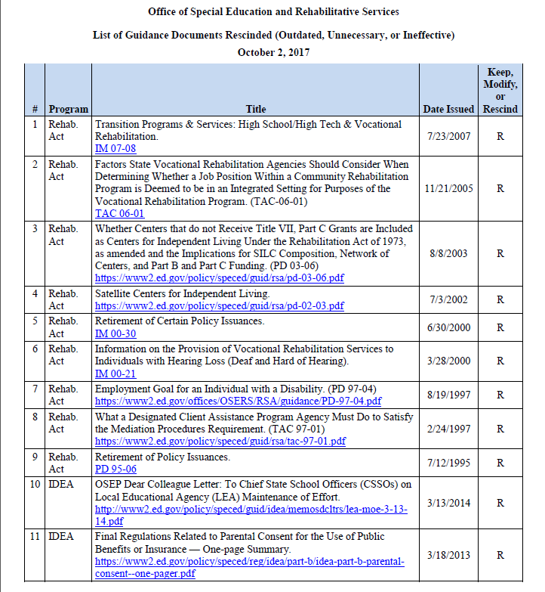
Notes:
72 rescinded outdated special education documents do not have an impact on current regulations according to the Secretary of Education and Trump administration

Slide 19
Questions ?

Slide 20
Issue #2 Compliance and Results Driven Accountability

Slide 21
When you’ve seen one state ~ you’ve seen one state
Professionals must be aware of differences and follow state and local requirements to remain in compliance.

Slide 22
Compliance Topics
Federal, state, and local regulations must be followed
Be aware of the current issues
Know the resources available in your state as well as SEACDC
Understand where to go for reliable information

Slide 23
Compliance Topics
Medicaid Audits
Make up Therapy
Document Outcomes
Telepractice

Slide 24
Documenting Student Outcomes
State Performance Plan (SPP) is a federally required plan that measures the state’s progress in implementing IDEA Part B.
It sets targets for 17 indicators of progress for students with disabilities.
The APR reports progress in meetings SPP targets on an annual basis to the US Department of Education.
https://www2.ed.gov/fund/data/report/idea/partbspap/index.html

Slide 25
Examples of Outcome Data
Indicator 1 — Improving graduation rates for students with disabilities
Indicator 3 — Ensuring all students with disabilities participate in statewide or alternate assessments
Indicator 4 — Reducing suspension and expulsion rates for students with disabilities
Indicator 5 — Providing services for students with disabilities in the least restrictive environment.
Indicator 8 — Improving parent involvement in their child’s special education program
Indicator 10 — Reducing the number of students from other cultures in certain disability categories

Slide 26
Medicaid Audits
Medicaid requires compliance with data collection and service delivery
Medicaid makes up some of the gap from underfunded IDEA (~17%)
Supports for SLPs
ASHA Medicaid Toolkit
ASHA Medicaid Committee Presentations and Posters
Self Audit Tools

Slide 27
Medicaid Self Audit Tool
Explains requirements
Provides checklist
Links to samples
References to tools
PDF Handout

Slide 28
ASHA Medicaid Committee Resources
Preparing for a Medicaid Audit in Schools (PDF tool)
Embracing Healthy Professional Habits (2015 ASHA Poster)
Medicaid Experts Provide Answers to Questions: What Everyday Leaders Need to Know (2016 ASHA Poster)

Slide 29
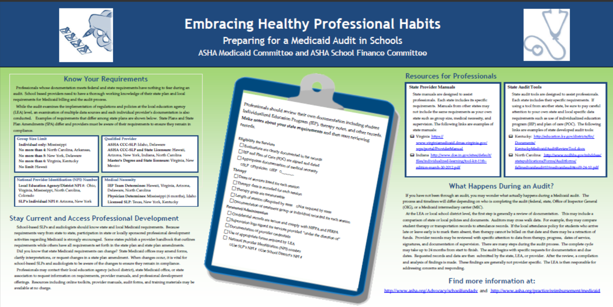

Slide 30
A Letter about Make Up Services
“ …encourage [schools] to consider the impact of a provider’s absence or a child’s absence on the child’s progress and performance and determine how to ensure the continued provision of FAPE in order for the child to continue to progress and meet the annual goals in his or her IEP. Whether an interruption in services constitutes a denial of FAPE is an individual determination that must be made on a case-by-case basis.”
http://www2.ed.gov/policy/speced/guid/idea/letters/2007-1/clarke030807disability1q2007.pdf

Slide 31
Another Letter on Make Up Services
“…the IEP Team must determine whether the child was denied educational benefit because of the disruption in educational services and whether compensatory education is needed to “make up” for the denial including addressing any skills that may have been lost…”
https://www2.ed.gov/policy/speced/guid/idea/memosdcltrs/12-023414-il-pergament-makeup.pdf

Slide 32
Make Up Services
State Perspective
Provision of FAPE (Free and appropriate public education)
In accordance with the IEP
Local Perspective
Risk Tolerance of LEA
Banking time in advance

Slide 33
“If it isn’t written down it didn’t happen”

Slide 34
Documentation
Date with MM/DD/YY
Record retention in accordance with your state and local requirements
LEA
Medicaid
HIPPA and FERPA compliant with communications
Emails to staff and others
Discussion board postings

Slide 35
Telepractice
Linking clinician to client or clinician to clinician for assessment, intervention, and/or consultation.
May not be appropriate in all circumstances or for all students.
Services must comply with national, state, institutional, and professional regulations and policies
https://www.asha.org/Practice-Portal/Professional-Issues/Telepractice/

Slide 36
Questions ?

Slide 37
Issue #3 Evidence Based Practices (EBP) and Assessment
Using “research based interventions to the extent practicable”

Slide 38
Evidence Based Practices

Slide 39
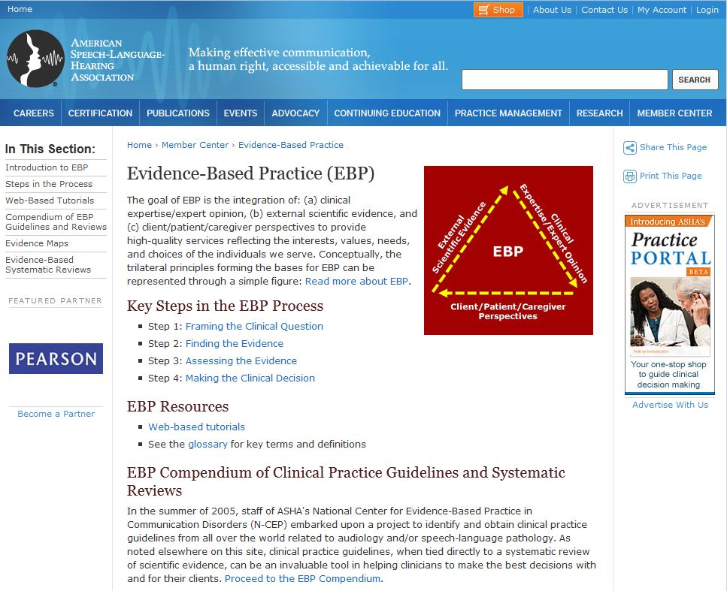

Slide 40
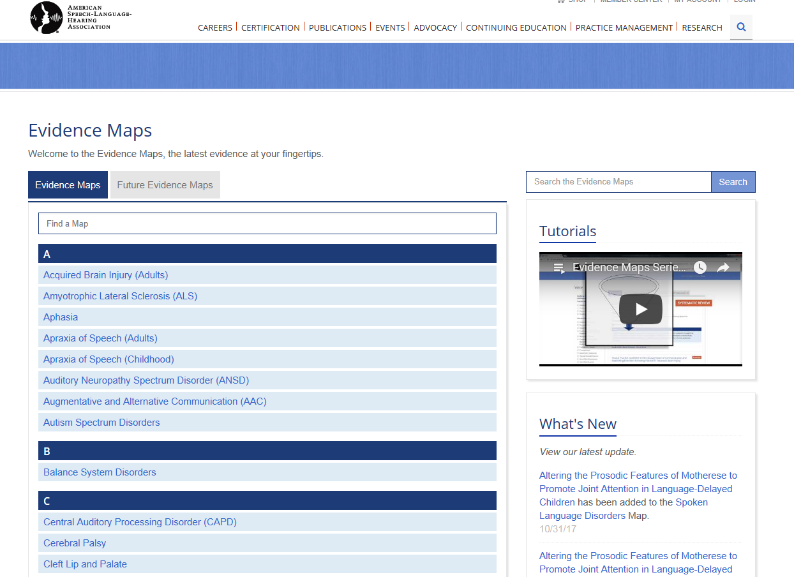

Slide 42
Psychometric Properties of Language Assessments for Children Aged 4–12 Years: A Systematic Review
Fifteen assessments were evaluated.
No assessments presented with evidence of structural validity, internal consistency or error measurement.
Overall, all assessments were identified as having limitations with regards to evidence of psychometric quality.
https://www.frontiersin.org/articles/10.3389/fpsyg.2017.01515/full

Slide 43
Diagnostic Accuracy: Vital Research
Eligibility Criteria for Language Impairment – Is the Low End of Normal Always Appropriate?
Of the 43 tests, acceptable accuracy (80% or better) was reported for only 5.
Spaulding, T. Plante, E. & Farinella, K. (2006) http://lshss.pubs.asha.org/article.aspx?articleid=1762895
Factors Influencing the Selection of Standardized Tests for the Diagnosis of Specific Language Impairment.
The quality of a standardized test, as measured by the test's psychometric properties, does not appear to influence how frequently a test is used.
Betz, S.K., Eickhoff, J.R., & Sullivan, S.F. (2013). http://lshss.pubs.asha.org/article.aspx?articleid=1797328

Slide 44
Characteristics of Auditory Processing Disorders: A Systematic Review
Examined 48 published studies on Auditory Processing Disorders (APD)
Characteristics were found to include difficulties that extend beyond the auditory modality.
The authors concluded that current empirical evidence does NOT support APD as a specific auditory condition.
Therefore, they suggest that intervention efforts should be “focused on cognitive or language skills rather than only auditory functioning” (p. 408).
de Wit, E., Visser-Bochane, M. I., Steenbergen, B., van Dijk, P., van der Schans, C.P., & Luinge, M. R. (2016). http://jslhr.pubs.asha.org/article.aspx?articleid=2515749

Slide 45
Language Variation and Theory of Mind in Typical Development: An Exploratory Study of School-Age African American Narrators.
The findings support culturally-fair assessment of narrative language skills and have application for classroom instruction in narrative performance.
False-belief mentioning and use of internal-state words may be dialect-neutral measurable aspects of narrative ability in typically developing students (Grades 2-5)
Mills, M. T., & Fox, M. (2016). http://ajslp.pubs.asha.org/article.aspx?articleid=2545938

Slide 46
Content Coverage of Single-Word Tests Used to Assess Common Phonological Error Patterns
None of the tests provided 4 opportunities for every error pattern.
Error patterns that tended to be underrepresented included:
weak syllable deletion
reduction of word-final clusters
fronting of velars
gliding of liquids
deaffrication
Kirk, C. & Vigeland, L. (2015). LSHSS 46(1), 14-29. doi: 10.1044/2014_LSHSS-13-0054.

Slide 47
A Psychometric Review of Norm-Referenced Tests Used to Assess Phonological Error Patterns
The tests included in this review failed to exhibit many of the psychometric properties required of well-designed norm-referenced tests. Of particular concern was lack of adequate sample size, poor evidence of construct validity, and lack of information about diagnostic accuracy.
Kirk, C. & Vigeland, L. (2014). LSHSS 45(4), 365-377. doi: 10.1044/2014_LSHSS-13-0053.

Slide 48
Comprehensive Assessment of Speech Sound Production in Preschool Children
Details on comprehensive speech sound assessment:
standardized single-word testing
additional single-word testing
connected speech sampling
phonological analyses
stimulability testing
may include inconsistency testing
Macrea (2016) http://perspectives.pubs.asha.org/article.aspx?articleid=2529456&resultClick=1

Slide 49
More Research
Test Review: PLS-5
LEADERS Project (2013). Retrieved from http://leadersproject.org/sites/default/files/PLS5- English-finaldraft.pdf
Test Review: CELF 5
LEADERS Project (2014). Retrieved from http://leadersproject.org/sites/default/files/ CELF5%20Test%20Review-LEADERS.pdf

Slide 50
Comprehensive Assessment Reference Card
Reviews comprehensive assessment process
Reviews data from 13 tests
Provides research references

Slide 51
Diagnostic Accuracy
The diagnostic accuracy of distinguishing a language difference from language impairment is substantially increased when LSA is used in conjunction with standardized testing (Horton-Ikard, 2010).

Slide 52
Research Shows Valuable Methods
Language Sample Analysis
Sampling Utterances Grammatical Analysis Revisited (SUGAR)
Narrative Sampling
SLAM Cards
Narrative Protocol for Picture Prompted Stories
Dynamic Assessment
Story Champs
Predictive Early Assessment of Reading and Language (PEARL)
NLM³

Slide 53
Dynamic Assessment Examine Learning Potential and Outcomes
Student Effort
Student Performance

Slide 54
Resources
www.seacdc.org/resources
http://www.seacdc.org/professional-development.html
www.omnie.ocali.org
www.doe.virginia.gov (Search SLP)
www.leadersproject.org

Slide 55
Talking EBP
Free Newsletter
2x per year
Need to Know
Test Your Knowledge
Practically Speaking
Working with Data
More to Explore

Slide 56
Questions ?

Slide 57
Key Issue #4 Disproportionality and Over identification

Slide 58
Disproportionate Representation
Nationally, there continues to be under or over identification of children from cultural and/or linguistic minorities in groups of children identified with disabilities.

Slide 59
IDEA Requirements
State education agencies must gather and examine such data (per IDEA 20 U.S.C. 1418(d) and 34 CFR §300.646)
State and local education systems required to take steps to address disproportionality (USDOE, 2015; IDEA reference 20 U.S.C. 1416(a)(3)(C); 34 CFR §300.600(d)(3).).

Slide 60
Risk Ratio Comparisons
Compares all students ratio to a sub group ratio

Slide 61
Disproportionate Representation
Indicator 10 — Reducing the number of students from other cultures in certain disability categories
Identification of LEA via Risk Ratio calculation
5 disability categories with required reporting
AUTISM
INTELLECTUAL DISABILITIES
EMOTIONAL DISABILITIES
SPECIFIC LEARNING DISABILITIES
SPEECH LANGUAGE IMPAIRMENT

Slide 62
Strengthening Criteria for Services
Addition of state specific regulations on
Criteria to address dialect and ELL impact
Criteria to address impact of poverty (SES)
Criteria to address lack of instruction (homelessness and migrant students)
Addition of state guidance on assessment considerations
Comprehensive Assessment
Dynamic Assessment
Dialect
Bias in testing
Notes:
Assessment work in Hawaii as an example: State push towards stronger assessment (language sampling & dynamic assessment)
Wisconsin has a language sampling guidelines/handbook (developed by Jon Miller)
Marie: Diagnostic accuracy and comprehensive approach to assessment.

Slide 63
Evaluation and Eligibility for Speech-Language Services in Schools
Reviews variations in terminology, federal and state regulations, and state, local, and professional guidance for cultural differences, dialect and the impact of poverty
Evaluation requirements and examples of differing state requirements and evidence-based recommendations
(Ireland & Conrad, 2016) http://perspectives.pubs.asha.org/article.aspx?articleid=2595559&resultClick=3

Slide 64
Professional Development
Support is offered in multiple states to provide suggestions for what SLPs can do to help address this issue, including:
Dialectal and linguistic variation considerations in assessment, instruction, and treatment
Low SES & poverty factors in assessing risk for LI and related disabilities
Informing evidence based decision making processes in your school/school system
Notes:
Assessment work in Hawaii as an example: State push towards stronger assessment (language sampling & dynamic assessment)
Wisconsin has a language sampling guidelines/handbook (developed by Jon Miller)
Marie: Diagnostic accuracy and comprehensive approach to assessment.

Slide 65
Resources
Racial And Ethnic Disparities In Special Education
Dialect
Understanding English Language Variation in U.S. Schools
Phonological Features of African American English
Poverty
Eric Jensen Teaching with Poverty in Mind
Increasing Oral and Literate Language Skills of Children in Poverty
Beginning with Babble LEAP Learning

Slide 66
Questions ?

Slide 67
Key Issue #5: Trending Workload/ Caseload Educational vs. Medical, MTSS, RtI, Pre-referral Intervention
o

Slide 68
Workload / Caseload
Most states fund schools using a headcount approach for all students with disabilities
Schools may adopt a workload model but cannot change funding formulas without significant legislative activity
Learn about your state’s funding model and how to advocate for change

Slide 69
Workload
ASHA supports a workload model in the schools
There are grassroots efforts underway in many local school systems to pursue a workload approach
Some states have taken strides in providing guidance documents or position statements in support of the workload approach.

Slide 70
Workload
In 2015, a few states began drafting legislative language for a workload approach.
Ohio-In July 2014, ODE adopted language to ensure districts utilize a two-prong approach looking at workload first and then caseload.
Eight guidance videos (link) were released to support districts’ use of workload & caseload prongs.
The Ohio licensing board is working with ODE and state associations to encourage implementation of the new process.
Notes:
Florida Task Force is drafting a wish list of workload approach for its schools.

Slide 71
Medical vs. Educational Models
Discuss differing requirements
Educational impact and need for specially designed instruction should be considered in school settings
Guidance available from a few states
Notes:
When a medical dx is presented, groups should address the difference between educational identification under IDEA and medical diagnosis and review the criteria for the specific disability category mandated by the Virginia special education regulations.

Slide 72
Prescriptions, diagnosis, or reports issued by licensed medical professionals, using medical diagnosis and classification systems … must be considered but are not sufficient to make an eligibility determination.
(Virginia Guidance)

Slide 73
Students may meet the criteria for educational identification as a child with a disability under one of the federal disability categories without having a medical diagnosis. It is also possible for a student to have a medical diagnosis but not meet the criteria for an educational identification as a child with a disability.
(Virginia Guidance)

Slide 74
Resources from States
Some states have existing guidance that addresses the differentiation between educational and medical models for assessment, diagnosis, eligibility, and treatment.
North Carolina
Virginia
Notes:
NEED MORE DEVELOPMENT IN THIS SLIDE.

Slide 75
Are you involved in general education programs? (RtI, MTSS, pre-referral initiatives)
Notes:
According to Deb Dixon, ASHA Schools, 80% of states use RTI. SLP roles within are varied by state, LEA, and even site within an LEA.
Audience Poll: Level of involvement in RTI: Are you/your SLPs involved in direct service provision, support for Tier 1 or Tier 2 instruction? Tier 3 intervention groups? Progress monitoring, general education interventions, etc?
Audience Poll: Is the SLP’s role in RTI: allowed, prohibited, optional?
Some states have a more formal or informal spin on RTI.

Slide 76
Role of School SLPS in MTSS
There is a growing trend nationally for SLPs working within the public education system to be involved in activities related to a Multi-Tiered System of Support (MTSS).
States may address caseload issues and staffing challenges that arise from involvement in these programs

Slide 77
Challenges for School SLPs
Variance in guidance for SLPs, workload and workload funding concerns (Dixon, 2013; Rudebusch & Wiechmann, 2011)
Scheduling difficulties (Rudebusch & Wiechmann, 2013)
Use of IDEA’s 15% funding for Coordinated Early Intervening Services (CEIS) to support various aspects of RTI
Recognizing the value of the SLP as an integral part of the whole in the school context
Notes:
In Ohio-the MTSS (still primarily referred to as RtI) process in our state looks different not only across districts but across bldgs within a district. In some instances, SLPs are heavily involved, facilitating the meetings at the get-go. In other areas they are left out of meetings due to heavy schedules, etc. My overall opinion is too many children are given a seat at the table with the students on IEPs rather than the SLP playing more of a consultative role. It’s just easier for them to provide the direct service adding the student to an existing time block rather than find time to work with the teacher, parapro, etc. We keep working on it though!-barb

Slide 78
References
ASHA (2010). Roles and responsibilities of speech-language pathologists in schools [Professional Issues Statement]. Available from www.asha.org/policy.
ASHA (2014a). 2014 Schools Survey, Caseload Characteristics Trends. Rockville: Author.
ASHA (2014b). 2014 Schools Survey, Educational Audiologists. Rockville: Author.
ASHA (2014c). 2014 Schools Survey, Speech-language Pathologists. Rockville: Author.
Dixon, D. (December, 2013). School matters: Response to intervention; Turning a challenge into an opportunity. ASHA Leader, 18, 30-31.

Slide 79
References
National School Boards Association (March 5, 2015). Letter of response to US Department of Education. Retrieved from www.nsba.org
Rudebusch, J., & Wiechmann, J. (August, 2011). How to fit response to intervention into a heavy workload. ASHA Leader.
Rudebusch, J., & Wiechmann, J. (August, 2013). Time block after time block. ASHA Leader, 18, 40-45.
USDOE (2015). Building the legacy: IDEA 2004. Retrieved from idea.ed.gov

Slide 80
Questions? Comments? Thank You

